Slide 1

Group 7 – Simple Games
ALFONS JANSSON, FRANCESCO MOSCHELLA, MICHAL SCHWOB, ERNEST POKROPEK, ZYLAN SHUKR, MARKO TOMIĆ

Slide 2

IDEA
Simple UI
Simple games
Low entry threshold

Slide 3
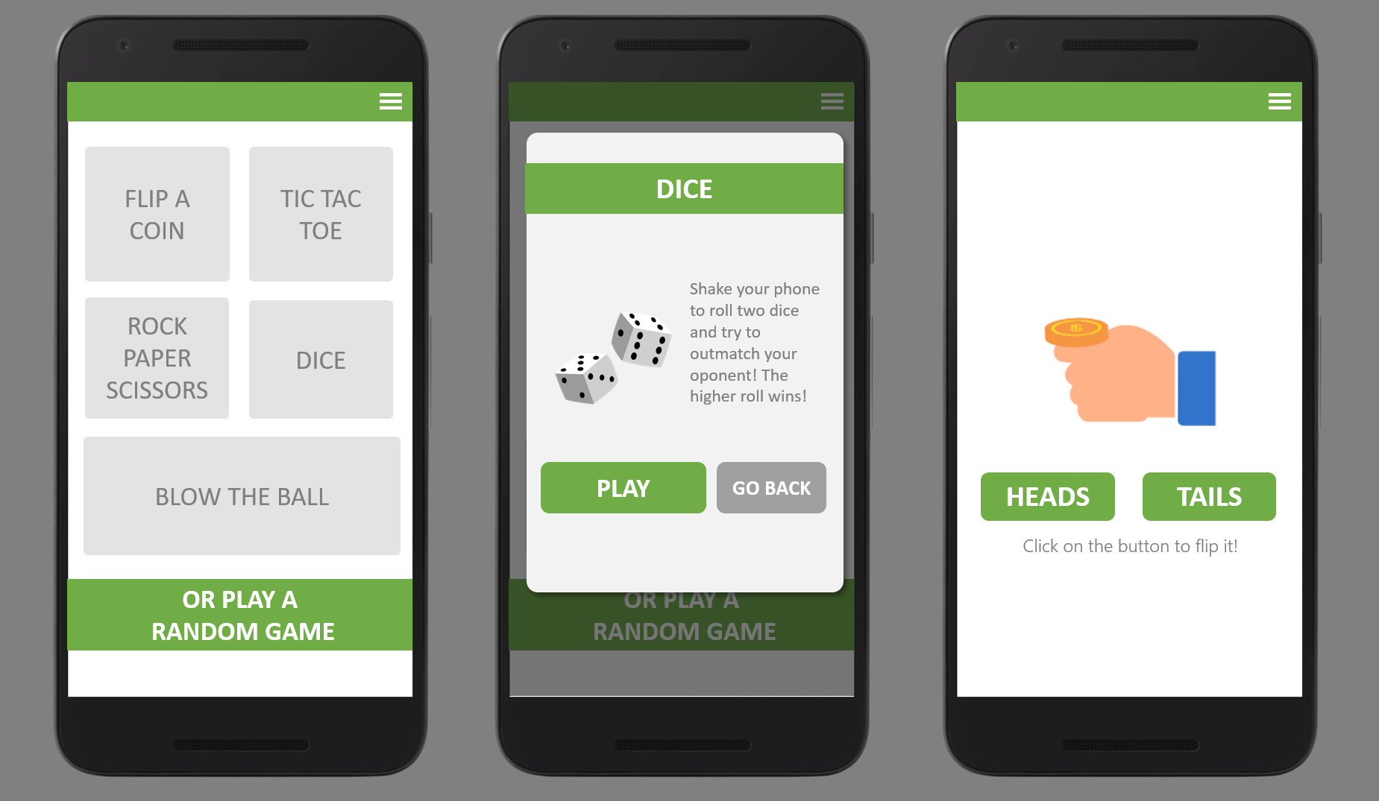

UI Design

Slide 4
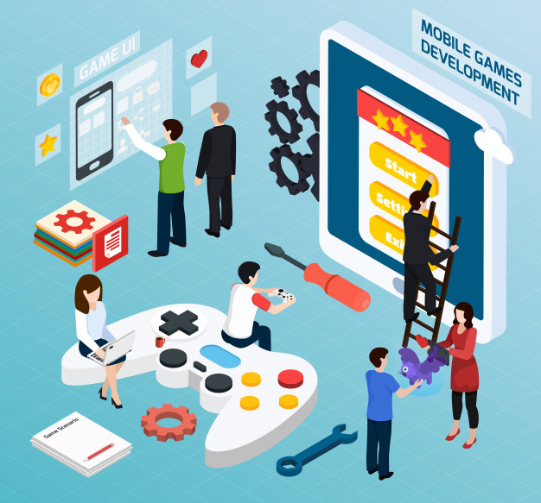
TECHNOLOGIES USED
Kotlin
Python
PHP
SQL

Slide 5

Available games
Tic-Tac-Toe
Rock, paper, scissors
Blow the ball
Dice
Flip the coin

Slide 6
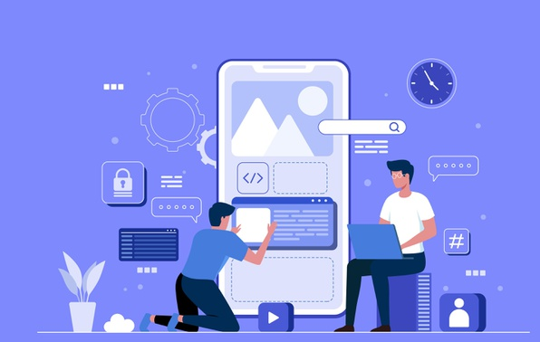
Technical stuff
Multiplayer
Communication
Pinging
Bots

Slide 7
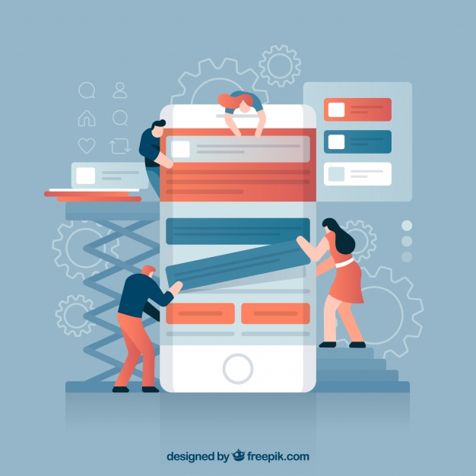
DEMO

Slide 8

Future plans
Animations
User accounts
More games
Gambling
User feedback
In-game currency

Slide 9

Thank you!
Questions?

